Slide 1
Class Project
Jeremy Bergmann - Omaha Data Science Academy

Slide 2
Purpose
To create an end-product that’s similar to what would be produced in a business environment, utilizing the knowledge gained in this course.
Steps – Data Science (CRISP-DM) Process
Understand Business Problem (What should you solve for?)
Understand Data
Prepare Data
Build Model/Data Flow
Test/Evaluate Process
Deployment - Answer business questions, Generate additional questions

Slide 3
Project Milestones
Import data into MySQL database (Class 1)
Query Data for Data Understaning/Relevant Information (Class 2)
Import data into MySQL database, clean data for analysis (Class 3-4)
Analyze Data Quality & Create Data Dictionary (Class 5)
Normalize data & Create Data Model (Class 6)
Automate data workflow using ETL, Python or Dataiku, Connect schema to Google Data Studio (Class 7)
Ask questions/finish project for professional portfolio (Class 8)

Slide 4
Business Questions
Useful questions often require basic domain knowledge
Characteristics of effective questions
Lead to action
Are specific
Clarify understanding
Focus on important features
Expose underlying issues

Slide 5
Business Questions
Sales
How many people are seeing our ads?
What is our conversion rate?
Who are top performing salespeople / What are our top performing ads?
Operations
What does it cost to make our product?
What products are encountering zero-inventory?
Financial Risk
Which customers are at risk of defaulting?
What is our exposure to catastrophic events?

Slide 6
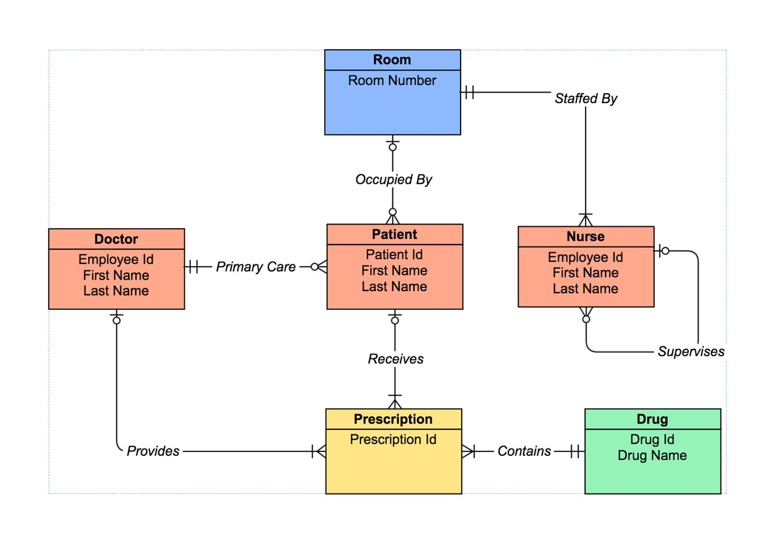
Project Data Sets - Examples
Hospital Entities
Examples
Euro 2012 data (.sql)
Consumer complaints data (.csv)
Veterinary clinic data (.csv)
Pets
Owners
Procedures history
Procedures details
Console data (.csv)
Game sales
Console dates
Notes:
Obj: 9, 10, 11
Recall the objective of learning and using SQL: ask and answer relevant questions
Map DBs, practice joins, extract dates

Slide 7
Resources & Recommendations
Cleaning
Data.world
Data.gov
World Bank
Reddit
Academic Torrents
Streaming
Twitter (see the API)
GitHub (see the API)
Quantopian
Weather Underground (see the API)
Recommendations
Find some data that interests you.
Practice importing it into Workbench and cleaning it
Document the process with git and sync with your GitHub account
Visualizing
Fivethirtyeight
BuzzFeed
Socrata
Processing
AWS
Google BigQuery
Wikipedia
Machine Learning
Kaggle
UCI
Quandl

Slide 8
Rubric
 | Sufficient
Documentation | Comments clarify complex code. Object names are intuitive. Code is easy to read.
Problem Formulation | Questions are relevant and answerable by the available data. Answers enable a decision by an interested party.
Database Design* | All tables adhere to 1NF. All tables are connected to at least one table. Database schema adheres to an appropriate schema.
Data Cleanliness | Data adhere to appropriate data types. Data is clean.
Code Optimization | SQL code optimized for storage or performance.
Database Creation | Tables have appropriate constraints.

